Slide 1
LIQUID PROPULSION
Week 11 Report

Slide 2
Tasks assigned for week 11
#142 Research on water-test design
#143 Mass flow rate re-calculation
#139 Remote operation

Slide 3
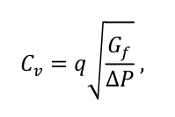
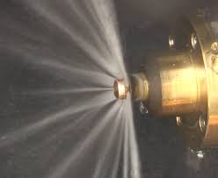
Water-flow test
Why water-flow test?
- Flow coefficient
- Injector spray formation
- Flow distribution within regeneration cooling

Slide 4
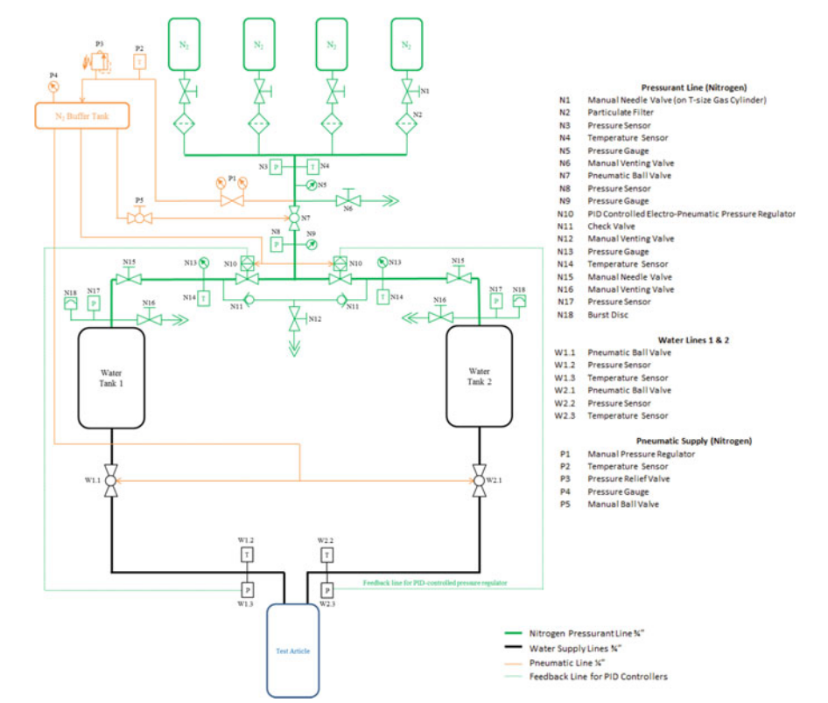
Water-Flow Test Stand
Schematic of LE’s water-flow test stand USC

Slide 5
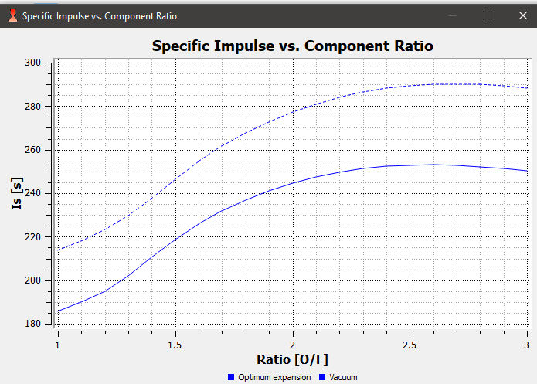
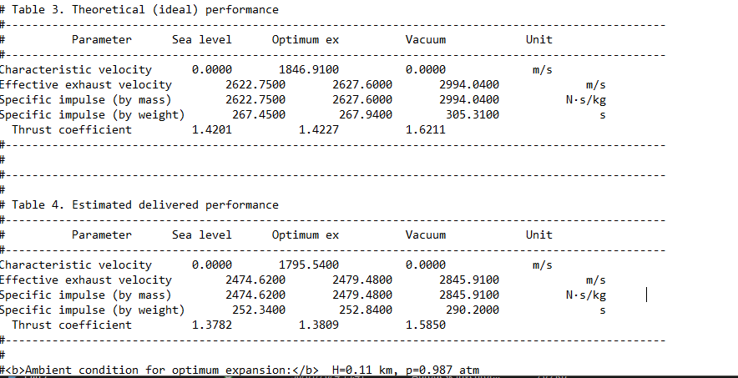
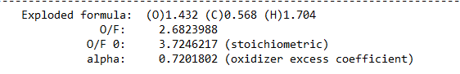
Mass flow rates & O/F
Mass flow rates & O/F RPA
Optimum O/F

Slide 6
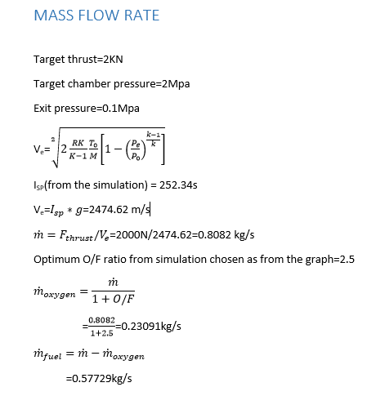
Mass flow rates
Finding of previous report
mass flow rate of Gox = 0.67093 kg/s
mass flow rate of ethanol = 0.5161 kg/s
Isp = 240s

Slide 7
Challenges in previous report
Unavailability of components locally
No suitable filling system or station could be found
Pressure accumulator is made up of Nitrile rubber which is incompatible with ethanol

Slide 8
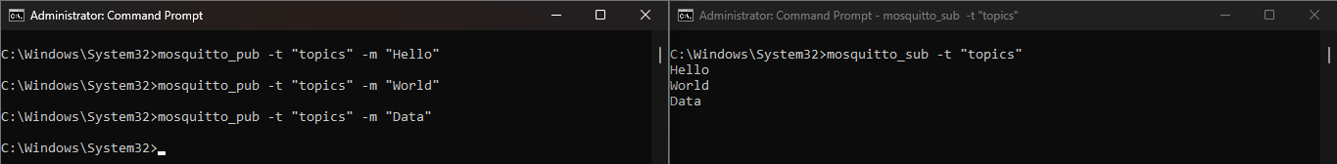
Remote operation
We choose MQTT as way of transmitting sensor data i.e. pressure data, flow rate
It works by publishing and subscribing to the same topic
MQTT is used where low bandwidth and low power consumption are crucial

Slide 9
Task allocated for next week
Design P & I D of water-test in 3D
Water-test control circuitry
Identify materials required
Remote operation

Slide 10
THANK YOU

